Slide 1

Denial of Service
CSE 405 January 2025 - Lecture 8
Special Thanks to Peyrin Kao (UC Berkeley)

Slide 2
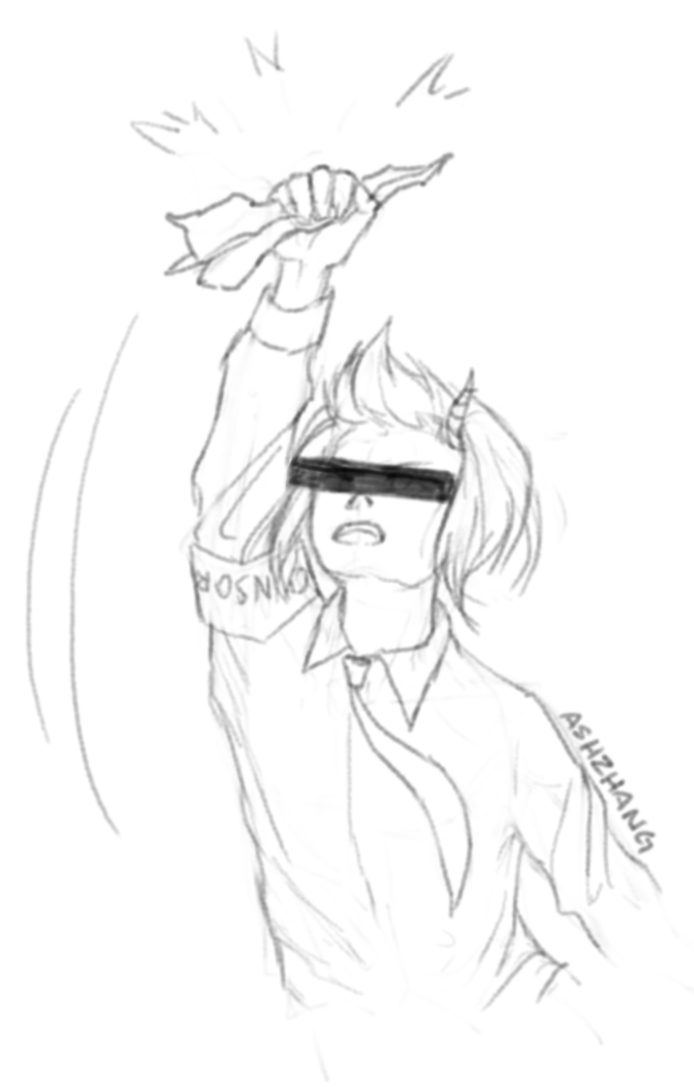
Today: Denial of Service and Firewalls
Denial of service
Availability
Application-level DoS
Algorithmic complexity attacks
Network-level DoS
Distributed DoS (DDoS)
Amplified DoS
SYN flooding
SYN cookies
Defenses
Firewalls
Packet filters
Stateless/stateful packet filters
Proxy firewalls
Notes:
Today we start end of class
Special side topics
No protocol front to back
Could prob teach a whole class on each topic but nto enough time

Slide 3
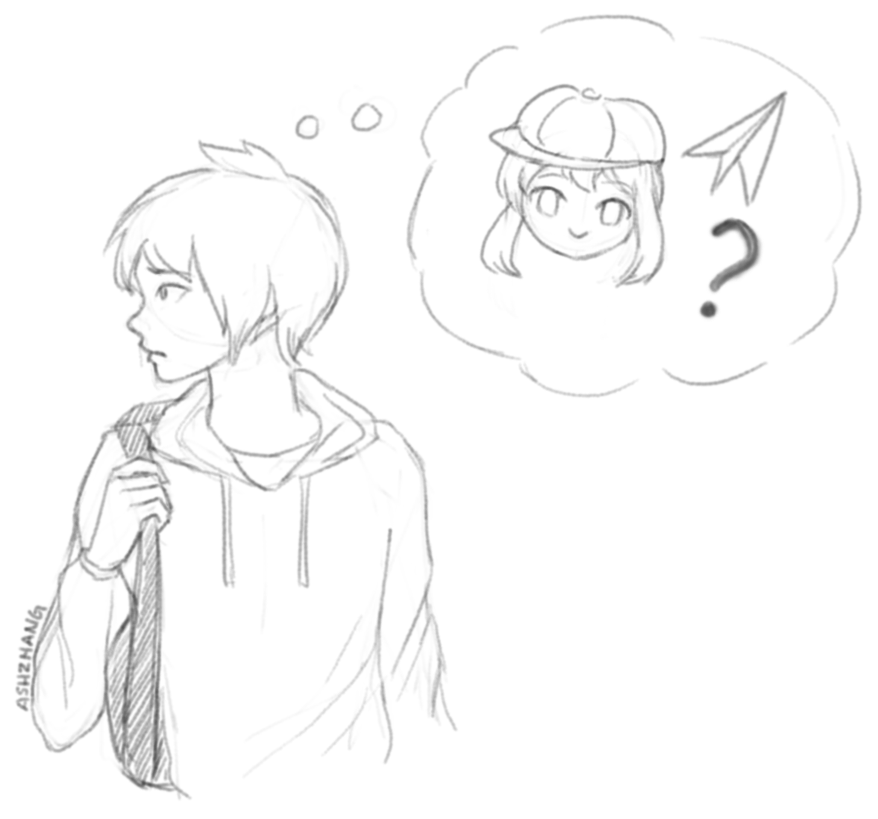
Denial of Service (DoS)
Notes:
Could fill a whole class but today will fill half a lecture

Slide 4
Availability and Denial of Service (DoS)
Availability: Making a service on the network available for legitimate users
Denial of service (DoS): An attack that disrupts availability of a service, making it unavailable for legitimate users
Competitors might DoS each other to benefit their own services
Criminals might DoS services unless the services pay a ransom
People might DoS services to make a political statement
Entities might DoS each other as part of warfare tactics
Some people might DoS for fun or revenge (e.g., online games)
Notes:
Property not dived into, availability
If have service want clients ot be able to use, want them to be able to use it
Why prevent them? Call back to lecture 1
The idea is dont want legit users to be able to access someone elses service
Example: when russia invaded Ukraine a lot of satellite internet when down
They first launched a DOS attack on the satellite network and while that was ongoing they broke into one of the control systems and sent bad updates to the modems rendering awhole bunch of satellite systems unusable just when they started their invasion
Dos has been seen in military attacks
Example: if youre too good ina game a competitor might dos you because if youre network goes down you cant keep playing

Slide 5

DoS in the News
 | Link
Digital Hit Men for Hire
Brian Krebs | August 1, 2011
Cyber attacks designed to knock Web sites off line happen every day, yet shopping for a virtual hit man to launch one of these assaults has traditionally been a dicey affair. That’s starting to change: Hackers are openly competing to offer services that can take out a rival online business or to settle a score. There are dozens of underground forums where members advertise their ability to execute debilitating “distributed denial-of-service” or DDoS attacks for a price. DDoS attack services tend to charge the same prices, and the average rate for taking a Web site offline is surprisingly affordable: about $5 to $10 per hour; $40 to $50 per day; $350-$400 a week; and upwards of $1,200 per month.
Notes:
https://krebsonsecurity.com/2011/08/digital-hit-men-for-hire/
2011: booter servies, or stress testers that promise to stress test your website in return for bitcoin or paypal, these booter services were $40 to knock somebodys net off for a day
Great way to get revenge

Slide 6

DoS in the News
 | Link
Extortion via DDoS on the rise
Denise Pappalardo and Ellen Messmer | May 16, 2005
Criminals are increasingly targeting corporations with distributed denial-of-service (DDoS) attacks designed not to disrupt business networks but to be used as tools to extort thousands of dollars from the companies. Those targeted are increasingly deciding to pay the extortionists rather than accept the consequences, experts say. While reports of this type of crime have circulated for several years, most victimized companies remain reluctant to acknowledge the attacks or enlist the help of law enforcement, resulting in limited awareness of the problem and few prosecutions.
Notes:
https://www.computerworld.com/article/2556543/extortion-via-ddos-on-the-rise.html
Extortion in 2005

Slide 7

DoS in the News
 | Link
DDoS makes a phishing e-mail look real
Munir Kotadia | November 8, 2006
Just as Internet users learn that clicking on a link in an e-mail purporting to come from their bank is a bad idea, phishers seem to be developing a new tactic -- launch a DDoS attack on the Web site of the company whose customers they are targeting and then send e-mails "explaining" the outage and offering an "alternative" URL.
Notes:
https://www.computerworld.com/article/2556543/extortion-via-ddos-on-the-rise.html
2006: dos to take the website down, use phishing to say use this link instead

Slide 8
DoS Attacks: Strategies
Exploiting program flaws
Software vulnerabilities can cause a service to go offline
Example: Exploit a buffer overflow to execute a shutdown command to the system
Example: Exploit a SQL injection vulnerability to delete the database
Resource exhaustion
Everything on the network has limited resources
The attacker consumes all the limited resources so legitimate users can’t use them
Notes:
Several strategies
What happens when you try to exploit a stack overflow when theres a stack canary? → crashes
Bad guy, dont like that server, im going to execute that stack overflow attack that cant compromise the server but causes it to crash, then crash again
Up and knock down again
Resource exhaustion: More common
Use more resources than the program has available and now real users cant use it

Slide 9
DoS Attacks: Strategies
Bottlenecks
Different parts of the system might have different resource limits
The attacker only needs to exhaust the bottleneck: the part of the system with the least resources
Bottleneck
Notes:
In both cases, particularly the second one, theres a bottleneck
Biggest thing to target
Narrowest resource int he system

Slide 10
DoS Targets
Application-level DoS: Target the high-level application running on the host
Network-level DoS: Target network protocols to affect the host’s Internet
Notes:
Can have application level
Can have network level
Also need to consider whether youre crashing or using resources
Choices you get to make

Slide 11
Application-Level DoS

Slide 12
Application-Level DoS
Target the resources that the application uses
Exploit features of the application itself
Some attacks rely on asymmetry: A small amount of input from the attack results in a large amount of consumed resources!
Notes:
Cause more work for victim than you had to do for attack

Slide 13
Resource Consumption
Idea: Force the server to consume all its resources
int fd = open('/tmp/junk');
char buf[4096];
while (1) { write(fd, buf, 4096); }
Exhausts filesystem space
while (1) { malloc(1000000000); }
Exhausts RAM
while (1) { fork(); }
Exhausts processing threads
while (1) {
int fd = open(random_file());
write(fd, "abcde", 5);
close(fd); }
Exhausts disk I/O operations
Notes:
Assume can run on victims computer
While 1 write junk
And keep writing it forever

Slide 14
Algorithmic Complexity Attacks
Consider an application that runs a sort on user-chosen data
What if the attacker intentionally chooses inputs that cause the worst-time runtime to occur?
Algorithmic complexity attack: Supplying inputs that trigger worst-case complexity of algorithms and data structures
Defense: Choose algorithms with good worst-case running times
Mergesort is safer than quicksort against DoS!
 | Expected runtime | Worst-case runtime
Mergesort | O(n log n) | O(n log n)
Quicksort | O(n log n) | O(n²)
Notes:
Attacker choses input that causes worse behavior
What is expected case lookup for a hash table? O(1) worse case? Linear
Force input taht causes this to happen

Slide 15
Application-Level DoS: Defenses
Identification: Step 0 of any defense
You must be able to distinguish requests from different users before you can do anything else!
Requires some method to identify/authenticate users
Authenticating users might be expensive and itself vulnerable to DoS
Isolation: Ensure that one user’s actions do not affect another user’s experience
Quotas: Ensure that users can only access a certain proportion of resources
Example: Only trusted users can execute expensive requests
Example: Limit each user to 4 GB of RAM and 2 CPU cores
Notes:
Identify attack, distinguish from normal behavior
Someone is trying to exhaust your resources
Spam log in requests, any part of your program that users interact with can be exploited
Quotas: so any given user can only issue expensiv requests up to a given amount
If every user has a quota, enforced under load

Slide 16
Application-Level DoS: Defenses
Proof-of-work: Force users to spend some resources to issue a request
Idea: Make a DoS attack more expensive for the attacker, who now needs to spend resources
Example: Add a CAPTCHA, which the attacker will now have to solve (or pay for solving services)
Overprovisioning: Allocate a huge amount of resources
Can cost the server a lot of money, but often the most effective defense
Content delivery network (CDN): A service that allocates a huge amount of resources, shared among everyone, and used only if needed
Example: Cloudflare runs your service for you with a huge amount of resources
Notes:
Proof of work: make use spend some resources before asking you to do something, make the asymmetric attacks a little more symmetrical
If you dont want to over provision: Content delivery network, its like insurance
We all pay a little bit of money it goes into a pool and helps whoever gets into an accident
Cloudflare does this for people
“Everybody buys into an insurance scheme”

Slide 17
Network-Level DoS
Notes:
Thats it for application level

Slide 18
Network-Level DoS
Target network protocols to degrade the victim’s Internet access
Example: Send a huge number of packets to the victim
Overwhelm the victim’s bandwidth (amount of data it can upload/download in a given time)
Example: The server can only upload/download 10 MB/s. The attacker sends the server 20 MB/s.
Lots of maximum-sized packets
Overwhelm the victim’s packet processing capacity
Example: The server can process 10 packets/second. The attacker sends the server 20 packets/second.
Lots of minimum-sized packets
Notes:
Instead of application itself, lets attack the network
Overwhelm the victims resources, liek bandwidth
Or limit to packets it can process, like 10 per second

Slide 19
Distributed Denial-of-Service (DDoS)
Distributed denial-of-service (DDoS): Use multiple systems to overwhelm the target system
Controlling many systems gives the attacker a huge amount of bandwidth
Sending packets from many sources makes it harder for packet filters to distinguish DDoS traffic from normal traffic
Botnet: A collection of compromised computers controlled by one attacker
The attacker can tell all the computers on the botnet to flood a given target
Attacker
Attacker
Attacker
Victim
Attacker
Attacker
Attacker
Notes:
Really powerful
Dangerous: multiple machines, advantage, lot of bandwidth
Spam data fromo all over the place
Now victim has a hard time to tell which packets are safe
How attacker get this many systems under control? Pay, attack, army of computers → botnet

Slide 20
Amplified Denial-of-Service
Amplified denial-of-service: Use an amplifier to overwhelm the target more effectively
Idea: Some services send a large response when sent a small request
Spoofing a small request that appears to come from the victim results in a large amount of data sent to the victim
Example: DNS amplification
Requests contain only the question
Responses contain answer records, authority records, and additional records
From: Victim, To: Server
request
Attacker
DNS Name Server
Victim
From: Server, To: Victim
RESPONSE
Notes:
before we talked about asymmetry and so we said well it would be really nice if the attacker just have to spend a little bit of money or a little bit of resources and then cause the victim to have to spend a ton of resources
Ex: go copy the dictionary. No work for me, lots for you
DNS amplification
Request is small
Single record whats the ip address of this domain
Response is huge
Use to attack, request takes no effort, response returns a ton of data
If i just send a packet to the victim thats symmetric
So how do i get the dns server to send to the victim → spoof!
From the victim, lie about where the packet came from

Slide 21
Amplified Denial-of-Service
Benefits:
The attacker’s identity is concealed because the packets come from the amplification server
The attacker is able to overwhelm victim with a lot of traffic, even if attacker's bandwidth is low
Attack bandwidth limited by capacity of DNS server, not of attacker
Drawbacks:
Requires blind spoofing capability ⇒ cannot work over TCP, since TCP spoofing is hard, only UDP protocols

Slide 22
Network-Level DoS: Defenses
Packet filter: Discard any packets that are part of the DoS attack
Discard packets where the source IP is the attacker’s IP address
Find some pattern in the content of the DoS packets to distinguish DoS packets from legitimate packets
The packet filter must be before the bottleneck
Attack: Subverting packet filters
Spoof DoS packets so that packets look like they’re coming from many IP addresses
Packet filters can’t use IP addresses to filter packets anymore!
Hard to defend against
Rely on anti-spoofing mechanisms on the network
Distributed DoS actually send packets from many IP addresses
Packet filters need to be much more sophisticated to defend against DDoS attacks
Notes:
Bc these are happening over networking layer, all packets streaming in, figure out which are good which are bad, use a filter

Slide 23
Network-Level DoS: Defenses
Overprovisioning: Purchase enough networking bandwidth and equipment to make it harder for attackers to overwhelm the network
Notes:
Works at every level
Why not always do ti? Costs money
Depends on threat model
Content delivery network like cloudflare – pay insurance

Slide 24
SYN Flooding and SYN Cookies
Notes:
That was high level ideas of DOS, approaches, defenses,
Now we’ll show you an example thats hammered out in like full attack on a protocol, give you flavor of what these attacks are like

Slide 25
SYN Flooding
A type of DoS that exploits a limit on how many TCP connections a server can track
Each connection established by the server needs to allocate some memory (to store sequence numbers, ACK numbers, buffered data, etc.)
Idea: Establish many connections with the server, causing it to consume a lot of memory
TCP state is allocated upon receiving a SYN
The attacker only needs to send the SYN, so the attacker doesn’t consume its own resources!
Attacker
Server
SYN. Seq = x
SYN-ACK. Seq = y, Ack = x+1
ACK. Seq = x+1, Ack = y+1
Notes:
Exploit TCP
Remember TCP handshake, 3 way, attacker sends sin, server sends synack, the attacker sends an ack → recap
Super common, everyone uses tcp all the time
When its started up, server allocates memory, to remember seq number, track data streaming in
What if the attacker forced server to start like 20 different TCP connections, 100, 1 million,
Now the server has to remember the seq numbers for 1 mill diff tcp connections, lots of data to remember
Maybe server runs out of memory before finishes
So overflow or overwhelm TCP
But this is kinda symmetric? For each connection the server remembers, doesnt the attacker also have to start up that connection? Istn that expensive for th attacker?
Exploit asym
Attacker goes first, server is obligated to allocate memory
Attacker knows the connections arent legit so when it receives a synack does it need to do anything back?
The attacker doesnt need to ack, the server has already allocated the memory,
If this happens over and over again server gets overwhelmed
None of those connections are ever finishing
Syn flooding, send a syn then forget about it right away

Slide 26
SYN Flooding: Defenses
Overprovisioning: Ensure the server has a lot of memory
Can be expensive
Filtering: Ensure that only legitimate connections will create state
Same problems as standard packet filtering for network-level DoS attacks
Can overwhelm the filter
Hard to distinguish legitimate traffic so early in the connection
Attacker can spoof source address since they only need to send the SYN, not the ACK
SYN cookies: Don’t store state!
Relies on the client to store the server’s state
The client returns the state to the server in the ACK packet of the handshake
Notes:
Have enough space for 1 mill connections
Filter: which tcp connections are legitimate
Syn cookies: why called cookies? Iguess were gonna send a litle bit of a state back to the attacker
The server says You made me allocate memory first, but im not gonna do that, im going to make you allocate memory first. Uno reverse card

Slide 27
Idealized SYN Cookies
Client
Server
The server generates state for the client but doesn’t save it, sending it to the client instead encoded with a secret
SYN. Seq = x
SYN-ACK. Seq = y. Ack = x+1. <State>
The client stores the state on behalf of the server and returns it in the ACK packet
Now that the handshake is complete, only now does the server allocate state for the connection, after checking the cookie against the secret
ACK. Seq = x+1, Ack = y+1. <State>. Data
Issue: TCP doesn’t have a mechanism to store state! What field of the SYN-ACK packet could we store data in?
Notes:
Before the client sends a syn to the server, the server is obligated to allocate a bunch of memory because the server has to prepare for the ocnnection to finish, so in other words teh server is going first
What if the server didnt go first, what would that look like
After reading through slide: i cant go back into tcp and add this state, thats going to break all of tcp, so where do we put this?

Slide 28
Practical SYN Cookies
Client
Server
The server generates state for the client but doesn’t save it, encoding it in the sequence number with a secret
SYN. Seq = x
SYN-ACK. Seq = <Encoded State>. Ack = x+1
The client remembers the sequence number and returns it in the ACK number
Now that the handshake is complete, only now does the server allocate state for the connection, after checking the cookie against the secret
ACK. Seq = x+1, Ack = <Encoded State>+1. Data
Notes:
Stick it in teh seq number
Seq number is just a bunch of 1s and 0s, 32bit

Slide 29
Practical SYN Cookies
Observation: The server doesn’t create state until the handshake is completed, so the attacker can’t spoof source addresses
Filtering becomes easier with SYN cookies
We can generalize this: Instead of holding state in the server, encode it with a secret and send it to the client, who will return it when it is next needed
Limitation: Sequence numbers only allow storing up to 32 bits of state (and maybe less, because maybe we want to include a MAC as well)

Slide 30
Firewalls

Slide 31
Motivation: Scalable Defenses
How do you protect a set of systems against external attack?
Example: A company network with many servers and employee computers
Observation: More network services = more risk
Each network service creates more opportunities for vulnerabilities (greater attack surface)
Turning off all network services is often infeasible (print services, SSH services, etc.)
Observation: More networked machines = more risk
What if you have to secure hundreds of systems?
What if the systems have different hardware, operating systems, and users?
What if there are some systems in the network that you aren’t aware of?
Instead of securing individual machines, we want to secure the entire network!
Notes:
Somebody managing company
Want ot protect the company against external attacks
Why is that so hard?
How do you know how many computers? Many are old? People click on malicious links? Too old to update? Computers you dont know about in teh network? Different operating systems?
Stop them all from being attacked!
Could go around trying to secure every single machine
Or could scale the entire network with one system

Slide 32
Firewalls and Security Policies
Idea: Add a single point of access in and out of the network, with a monitor
“Ensure complete mediation”
Any traffic that could affect vulnerable systems must pass through the firewall
Network access is controlled by a policy
Defines what traffic is allowed to exit the network (outbound policy)
Defines what traffic is allowed to enter the network (inbound policy)
Policy model based on our threat model: We usually assume users “inside” the network are trusted, and those outside are not
Internet
Firewall
Notes:
Real life analogy: (disclaimer, analogies are not always indicative of real life) some countries historically have built a wall or built their city near a mountain as a natural barrier to protect their civilization. This is one system to protect an entire network.
Single point of access, anyone outside has to enter through the checkpoint call this the firewall
Everyone is mediated thru firewall
What does it do? It sits there, some program you dont write
Received this input from outside
Someone from inside wants to send this packet
Firewall judges and says this is allowed to pass thru or not, block it
Write the code thats allowed and not allowed
Depends on threat model
Do you let everyone in? No one? Probably something inbetween
We trust that everyon inside is trustworthy and everyone outside is not
Thats why they all go thru the checkpoint, because inside is trusted

Slide 33
Firewalls and Security Policies
What’s the policy of a standard home network?
Outbound policy: Allow outbound traffic
Users inside the network can connect to any service
Inbound policy: Only some traffic is able to enter the network
Allow inbound traffic in response an outbound connection
Allow inbound traffic to certain, trusted services (e.g. SSH)
Deny all other inbound traffic
Allow outbound traffic
Internet
Firewall
Allow trusted inbound traffic
Deny other inbound traffic
Notes:
Outbound is trusted because everyon inside is trustworthy

Slide 34
Default Security Policies?
How should we handle traffic that isn’t explicitly allowed or denied?
Default-allow policy: Allow all traffic, but deny those on a specified denylist
As problems arise, add them to the denylist
Default-deny policy: Deny all traffic, but allow those on a specified allowlist
As needs arise (or users complain), add them to the allowlist?
Which default policy is best?
Default-allow is more flexible, but policy mistakes are vulnerabilities and can be catastrophic
Default-deny is more conservative, but policy mistakes are less painful
Default-deny is generally accepted to be the best default policy (“consider fail-safe defaults”)
Default-allow is worse for security; Default-deny is worse for usability
Notes:
Not going to write a rule for every request, too many packets out there
Default

Slide 35
Stateless Packet Filters
Firewalls are often packet filters, which inspect network packets and choose what to do with them
Option #1: Allow the packet to pass through the firewall, forwarding it onwards
Option #2: Deny the packet from passing through the firewall, dropping it
Stateless packet filters
Packet filters that have no history
All decisions must be made using only the information in the packet itself
Can have trouble implementing complex policies that require knowledge of history
Notes:
Simplest is stateless: going to look at every packet individually
so you're not going to think about the packet that came like five minutes ago
or you're not going to like think about packets that could hypothetically come in the future
you're going to say there's one packet in front of me right now I'm going to look at just that packet and nothing else
that's called stateless because you're not remembering State
and so that means that the only thing you can use to judge if the packet is good or not is the packet itself
you can't think about things in the past don't think about things in the future
Simple but might miss some attacks

Slide 36
Stateless Packet Filters
Consider implementing the typical home network policy from earlier:
Allow outbound traffic
Allow inbound traffic in response to an outbound connection
Deny all other inbound traffic
Issue: How do we know what inbound traffic is in response to an outbound connection?
TCP: Can be filtered statelessly, with a hack
Allow inbound traffic with the ACK flag set
Deny inbound traffic without an ACK flag set
If the internal computer sees an ACK packet without having formed a connection, it will ignore it or send a RST
UDP: Impossible to filter, with a stateless packet filter
UDP “connections” are typically implemented at the application layer, so we can’t inspect much
Notes:
How could you implement one of our policies form earlier usinga stateless packet filter
If youre using TCP, how can i tell if something is a reply or not
If replying, theres an ACK flag set
If someone on the outside is trying to connect to the inside, what would they send? A syn packet with no ack flag set, see that and deny it
Ask students if they see issues with implementing these rules

Slide 37
Stateful Packet Filters
A better idea: Keep state in the implementation of the packet filter
The filter keeps track of inbound/outbound connections
Notice: All connections have packets going in both directions, so a stateless filter could not do this
Rules define what connections are allowed or denied
Ultimately, packets are still either forwarded or dropped
Example rules:
allow tcp connection 4.5.5.4:* -> 3.1.1.2:80
Allow connections from 4.5.5.4 to 3.1.1.2 with destination port 80
allow tcp connection *:*/int -> *:80/ext
Allow outbound connections with destination port 80
allow tcp connection *:*/int -> *:*/ext
Allow all outbound connections
allow tcp connection *:*/ext -> 1.2.2.3:80
Allow inbound connections to 1.2.2.3 with destination port 80
Notes:
Keep state
Remember packets that came before
Not thinking about packets one by one
Can assemble packets into a connections
Can think about connections
Whats inbound and outbound
Get a packet, either good or not good, but think about it in terms of connections
* is for anything, wildcard

Slide 38
Stateful Packet Filters
Stateful packet filters can also track the state of well-known applications
Example: Decoding and tracking HTTP requests/responses
Example: Tracking the files sent in a FTP (File Transfer Protocol) connection
Notes:
can be smarter so instead of looking at every packet one by one you can reassemble pack packets in TCP like use the sequence numbers to reassemble if you're using something like HTTP you can be even smarter and reassemble that too and be like oh that's a get request and that's a post request and maybe like I'll accept post requests but I won't allow get requests
Can be smarter
But more expensive to implement

Slide 39
State in an FTP Rule
Consider this rule: “Allow all inbound FTP connections, except those logging in as root”
What state does the packet filter have to track?
Source IP, destination IP, source port, destination port, etc.
Whether this is an FTP connection or not
Status of the FTP connection (what command is executed)
Username
Or just the first 5 bytes of the username…
Otherwise, the attacker could send a really long username and DoS the firewall
Takeaway: To keep track of applications, firewalls must be smart about how they store state
Notes:
here's an example in ftp
so ftp is a file transfer protocol
allow all inbound ftp connections except for those logging in as root
so the packet filter needs to know
Source ip destination ip
Source port destination port
if it's an ftp connection
if so where in the ftp connection it is
the username of the ftp connection
and you're gonna wanna stop after five bytes or so of the username because otherwise the attacker is going to send really really really long usernames and tie up a lot of memory on your firewall
and so to actually keep track of applications the firewalls really do have to be fairly hard about storing state and fdp deserves a special notice
ftp is a nightmare
this is a really really really old networking protocol standardized in 1985.
it's older than you
and it's used often enough that you'll still need it
so how many have seen url links that are ftp colon slash slash
that says use file transfer protocol to get it
and file transfer protocol is broken
most client server protocols have this model where the client creates a tcp connection and requests data and it comes over the connection
guess what
ftp doesn't do this
the client creates a connection to the server
but to send an actual file the client starts a tcp service
tells the server hey contact me on this tcp port
and the server then connects back to the client
yes i'm seeing these mystified faces no i'm not explaining it wrong yes it is that stupid
this was before we came up with the idea of the firewall
so as a consequence the firewall needs to understand ftp because ftp is not designed to work well with firewalls
and this is what's known as supporting a legacy protocol something really really really old and crufty
it's often a real pain
in computing life would be so much better for us if we could say anything over five years old we just toss a molotov cocktail and burn it down you'll never be in that position

Slide 40
Evading Packet Filters
Consider a simple example: Deny all connections containing the string root
Deny packets that contain the sequence of bytes r, o, o, and t
Allow all other packets
From: A | To: B
Seq = 4
Hello world
✓
From: C | To: D
Seq = 2
Log in
✓
From: C | To: D
Seq = 8
as root
✗
Notes:
Lets choose a policy: deny all conections containing the string root
That user is trying to log in as admin user
Lets be a stateless packet filter and look thru these examples

Slide 41
Evading Packet Filters
TCP splits messages are split into packets
Packets can arrive out of order: The application will use sequence numbers to reorder packets
Attack: Split the word root across packets
No single packet contains root, so the firewall won’t stop any of these packets
Attack: Send the split packets out of order
Now the firewall has to reconstruct TCP connections to detect the root message
Seq = 6
o
o
Seq = 4
r
r
Seq = 5
o
o
Firewall
Seq = 7
t
t
Notes:
How to stop this attack? Needs to be smarter, able to assemble packets

Slide 42
Evading Packet Filters
IP packets have a time-to-live (TTL)
The number of hops a packet may take before the packet is dropped
The attacker can easily find how many hops away a given server is
Technique: Send ping packets with increasing TTLs until the server responds
If the destination takes more hops than the firewall, the attacker can exploit this
Send multiple packets with the same sequence number, setting the TTLs on the dummy packets so that they are dropped before the reach the destination
Seq = 4, TTL = 16
n
Seq = 4, TTL = 22
r
r
Seq = 5, TTL = 22
o
o
Seq = 5, TTL = 16
i
Firewall
Seq = 6, TTL = 22
o
o
Seq = 6, TTL = 16
c
Seq = 7, TTL = 16
e
Seq = 7, TTL = 22
t
t
Notes:
Another more sophisticated attack
TTL: you're out of time this packet gets dropped and this avoids having packets like Bounce Around the internet forever
Multiple packets witht eh same seq number

Slide 43
Evading Packet Filters
Difficult for the stateful packet filter to defend against
TTLs for different packets naturally vary, since packets may take different routes
Storing all possible combinations takes exponential space
Hard to predict which packets will reach the destination and which won’t
Seq = 4, TTL = 16
n
Seq = 4, TTL = 22
r
r
Seq = 5, TTL = 22
o
o
Seq = 5, TTL = 16
i
Firewall
Seq = 6, TTL = 22
o
o
Seq = 6, TTL = 16
c
Seq = 7, TTL = 16
e
Seq = 7, TTL = 22
t
t
Notes:
Could be vulnerable to DOS

Slide 44
Other Types of Firewalls
Proxy firewall: Instead of forwarding packets, form two TCP connections: One with the source, and one with the destination
The firewall is really just a MITM, so it can easily spoof the addresses of the end hosts
Avoids problems with evasion, since the firewall has direct access to the TCP byte streams
Application proxy firewall: Certain protocols allow for proxying at the application layer
Example: HTTP proxies will make an HTTP request on behalf of the user then return the HTTP response to the client
Client (outside)
TCP
Firewall
TCP
Server (inside)
Notes:
Other types of firewalls

Slide 45
Alternatives to Allowing Firewall Traffic
Virtual private network (VPN): A set of protocols that allows direct access to an internal network via an external connection
Creates an encrypted tunnel to allow internal network traffic to be sent securely over the Internet
Intuition: The encrypted tunnel is an emulated Ethernet cable that allows you to connect “inside” the network
The firewall allows VPN traffic, which allows arbitrary traffic to be tunneled inside
Internet
Firewall
Notes:
Think back to company example
Employee goes on a trip in a diff country, but firewall thinks youre on the outside now
Vpn creates tunnel, secure tls connection thats going to connect from the employee on a business trip on the outside directly thru TLS to a connection or a server on the inside
anytime the server or the person on the outside wants to make a request they're not going to make the request from their computer outside because the firewall would block that they're instead going to make the request through the tunnel to the server on the inside and then the VPN on the inside can now make the request so now this employee looks like they're still at home in the office even though they've gone somewhere else

Slide 46
Firewall Pros and Cons
Pros
Centralized management of security policies (single point of control)
Transparent operation to end users
Mitigates security vulnerabilities on end hosts (e.g., block anything that looks like shellcode)
Cons
Reduced network connectivity: Some applications don’t work well inside a firewall
Vulnerability to “insiders”
Employees could be bribed or threatened
Devices are often brought from into the network outside (e.g., cell phones, laptops)
Once one device is compromised, attackers can quickly spread through the network
Could be mitigated by layering firewalls for more sensitive devices
Notes:
* Like Eskimo Pies: “hard crunchy exterior, soft creamy center”

Slide 47
Summary: Denial of Service
Availability: Making sure users are able to use a service
DoS attacks availability of services
Application-level DoS: Attacks the application's algorithms/code
Algorithmic complexity attacks: Attack using inputs that cause the worst-case runtime of an algorithm
Defense: Identification, isolation, and quotas
Defense: Proof of work
Network-level DoS: Attacks the network of a service
Typically floods either the network bandwidth or the packet processing capacity
Distributed DoS: Use multiple computers to flood a network at the same time
Amplified DoS: Use an amplifier to turn a small input into a large output, spoofing packets so the reply goes to the victim
Defense: Packet filtering
All DoS attacks can be defended against by overprovisioning

Slide 48
Summary: SYN Cookies
SYN flooding: A type of DoS that causes a server to allocate state for unfinished TCP connections, upon receiving a SYN packet
SYN cookies: Instead of allocating state when receiving a SYN, send the state back to the client in the sequence number
The client returns the state back to the server, which it only then allocates state for

Slide 49
Summary: Firewalls
Firewalls: Defend many devices by defending the network
Security policies dictate how traffic on the network is handled
Packet filters: Choose to either forward or drop packets
Stateless packet filters: Choose depending on the packet only
Stateful packet filters: Choose depending on the packet and the history of the connection
Attackers can subvert packet filters by splitting key payloads or exploiting the TTL
Proxy firewalls: Create a connection with both sides instead of forwarding packets

